Slide 1
Web and HTTP - II

Slide 2


Web caches
Goal: satisfy client requests without involving origin server
user configures browser to point to a (local) Web cache
browser sends all HTTP requests to cache
if object in cache: cache returns object to client
else cache requests object from origin server, caches received object, then returns object to client
Web
cache
HTTP request
HTTP request
client
HTTP response
HTTP response
origin
server
HTTP request
HTTP response
client
Notes:
t’

Slide 3


Web caches (aka proxy servers)
Web cache acts as both client and server
server for original requesting client
client to origin server
Why Web caching?
reduce response time for client request
cache is closer to client
reduce traffic on an institution’s access link
Internet is dense with caches
enables “poor” content providers to more effectively deliver content
server tells cache about object’s allowable caching in response header:
Notes:
re: poor content providers – like in real-estate, location is everything. servers want to be close to clients.

Slide 4
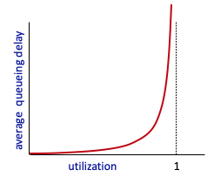


Caching example
Scenario:
access link rate: 1.54 Mbps
RTT from institutional router to server: 2 sec
web object size: 100K bits
average request rate from browsers to origin servers: 15/sec
avg data rate to browsers: 1.50 Mbps
origin
servers
public
Internet
1.54 Mbps
access link
Performance:
access link utilization = .97
LAN utilization: .0015
end-end delay = Internet delay +
access link delay + LAN delay
= 2 sec + minutes + usecs
problem: large queueing delays at high utilization!
institutional
network
1 Gbps LAN
Notes:
explain why minutes (recall earlier delay versus arrival rate curve from Chapter 1)

Slide 5
Option 1: buy a faster access link
Scenario:
access link rate: 1.54 Mbps
RTT from institutional router to server: 2 sec
web object size: 100K bits
average request rate from browsers to origin servers: 15/sec
avg data rate to browsers: 1.50 Mbps
154 Mbps
origin
servers
public
Internet
154 Mbps
1.54 Mbps
access link
Performance:
access link utilization = .97
LAN utilization: .0015
end-end delay = Internet delay +
access link delay + LAN delay
= 2 sec + minutes + usecs
.0097
institutional
network
1 Gbps LAN
Cost: faster access link (expensive!)
msecs
Notes:
t’

Slide 6
Option 2: install a web cache
Scenario:
access link rate: 1.54 Mbps
RTT from institutional router to server: 2 sec
web object size: 100K bits
average request rate from browsers to origin servers: 15/sec
avg data rate to browsers: 1.50 Mbps
origin
servers
public
Internet
1.54 Mbps
access link
Cost: web cache (cheap!)
institutional
network
Performance:
LAN utilization: .?
access link utilization = ?
average end-end delay = ?
1 Gbps LAN
How to compute link
utilization, delay?
local web cache

Slide 7
Calculating access link utilization, end-end delay with cache:
suppose cache hit rate is 0.4:
40% requests served by cache, with low (msec) delay
origin
servers
public
Internet
60% requests satisfied at origin
rate to browsers over access link
= 0.6 * 1.50 Mbps = .9 Mbps
access link utilization = 0.9/1.54 = .58 means low (msec) queueing delay at access link
1.54 Mbps
access link
institutional
network
average end-end delay:
= 0.6 * (delay from origin servers)
+ 0.4 * (delay when satisfied at cache)
= 0.6 (2.01) + 0.4 (~msecs) = ~ 1.2 secs
1 Gbps LAN
local web cache
lower average end-end delay than with 154 Mbps link (and cheaper too!)
Notes:
t’

Slide 8
Conditional GET
client
server
Goal: don’t send object if cache has up-to-date cached version
no object transmission delay (or use of network resources)
client: specify date of cached copy in HTTP request
If-modified-since: <date>
server: response contains no object if cached copy is up-to-date:
HTTP/1.0 304 Not Modified
HTTP request msg
If-modified-since: <date>
object
not
modified
before
<date>
HTTP response
HTTP/1.0
304 Not Modified
HTTP request msg
If-modified-since: <date>
object
modified
after
<date>
HTTP response
HTTP/1.0 200 OK
<data>
Notes:
t’

Slide 9

FTP: the file transfer protocol
file transfer
FTP
user
interface
FTP
client
FTP
server
user
at host
remote file
system
local file
system
transfer file to/from remote host
client/server model
client: side that initiates transfer (either to/from remote)
server: remote host
ftp: RFC 959
ftp server: port 21

Slide 10
FTP: separate control, data connections
FTP client contacts FTP server at port 21, using TCP
client authorized over control connection
client browses remote directory, sends commands over control connection (username and password, commands to
change remote directory, and commands to “put” and “get” files)
when server receives file transfer command, server opens 2nd TCP data connection (for file) to client
after transferring one file, server closes data connection
TCP control connection,
server port 21
FTP
client
TCP data connection,
server port 20
FTP
server
server opens another TCP data connection to transfer another file
control connection: “out of band”
FTP server maintains “state”: current directory, earlier authentication
HTTP “in-band” sends request
and response header lines into the same TCP connection that carries the transferred
file itself

Slide 11
FTP commands, responses
sample commands:
sent as ASCII text over control channel
USER username
PASS password
LIST return list of file in current directory
RETR filename retrieves (gets) file
STOR filename stores (puts) file onto remote host
sample return codes
status code and phrase (as in HTTP)
331 Username OK, password required
125 data connection already open; transfer starting
425 Can’t open data connection
452 Error writing file

Slide 12
Electronic mail
outgoing
message queue
user mailbox
Three major components:
user agents
mail servers
simple mail transfer protocol: SMTP
User Agent
a.k.a. “mail reader”
composing, editing, reading mail messages
e.g., Outlook, Thunderbird, iPhone mail client
outgoing, incoming messages stored on server
user
agent
mail
server
user
agent
SMTP
mail
server
user
agent
SMTP
SMTP
user
agent
mail
server
user
agent
user
agent

Slide 13
Electronic mail: mail servers
mail servers:
mailbox contains incoming messages for user
message queue of outgoing (to be sent) mail messages
SMTP protocol between mail servers to send email messages
client: sending mail server
“server”: receiving mail server
user
agent
mail
server
user
agent
SMTP
mail
server
user
agent
SMTP
SMTP
user
agent
mail
server
user
agent
user
agent

Slide 14
Electronic Mail: SMTP [RFC 2821]
uses TCP to reliably transfer email message from client to server, port 25
direct transfer: sending server to receiving server
three phases of transfer
handshaking (greeting)
transfer of messages
closure
command/response interaction (like HTTP, FTP)
commands: ASCII text
response: status code and phrase
messages must be in 7-bit ASCI

Slide 15

Scenario: Alice sends message to Bob
1) Alice uses UA to compose message “to” bob@someschool.edu
2) Alice’s UA sends message to her mail server; message placed in message queue
3) client side of SMTP opens TCP connection with Bob’s mail server
4) SMTP client sends Alice’s message over the TCP connection
5) Bob’s mail server places the message in Bob’s mailbox
6) Bob invokes his user agent to read message
user
agent
mail
server
user
agent
1
mail
server
2
3
6
4
Alice’s mail server
5
Bob’s mail server

Slide 16
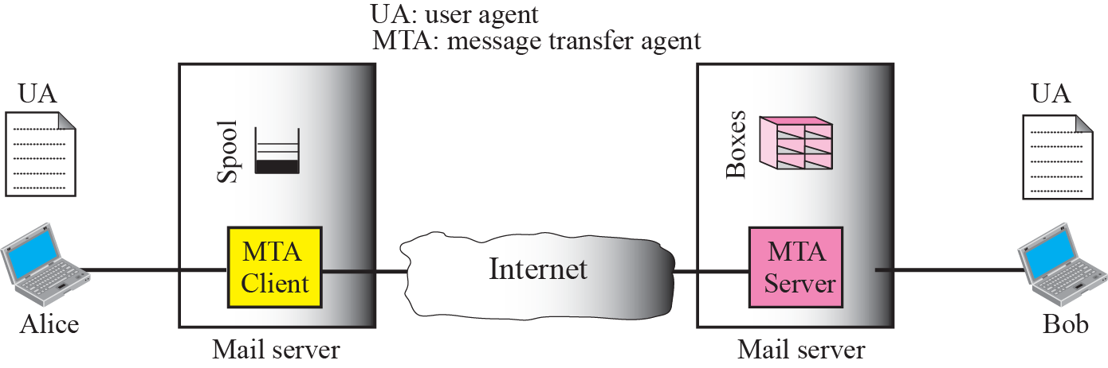
Scenario: Alice sends message to Bob

Slide 17
Sample SMTP interaction
S: 220 hamburger.edu
C: HELO crepes.fr
S: 250 Hello crepes.fr, pleased to meet you
C: MAIL FROM: <alice@crepes.fr>
S: 250 alice@crepes.fr... Sender ok
C: RCPT TO: <bob@hamburger.edu>
S: 250 bob@hamburger.edu ... Recipient ok
C: DATA
S: 354 Enter mail, end with "." on a line by itself
C: Do you like ketchup?
C: How about pickles?
C: .
S: 250 Message accepted for delivery
C: QUIT
S: 221 hamburger.edu closing connection

Slide 18
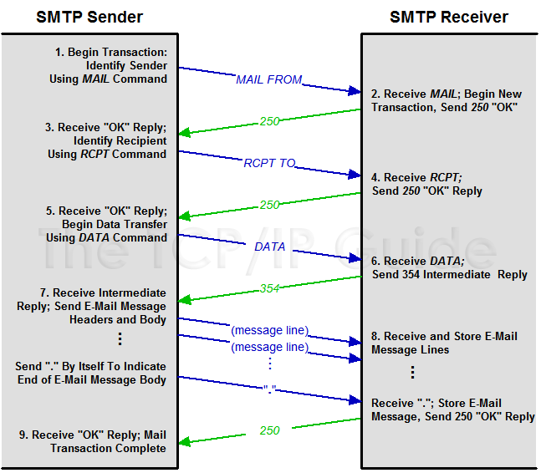
http://www.tcpipguide.com/free/t_SMTPMailTransactionProcess-3.htm

Slide 19
Try SMTP interaction for yourself:
telnet servername 25
see 220 reply from server
enter HELO, MAIL FROM, RCPT TO, DATA, QUIT commands
above lets you send email without using email client (reader)

Slide 20
SMTP: final words
SMTP uses persistent connections
SMTP requires message (header & body) to be in 7-bit ASCII
comparison with HTTP:
HTTP: pull
SMTP: push
both have ASCII command/response interaction, status codes
HTTP: each object encapsulated in its own response msg
SMTP: multiple objects sent in multipart msg

Slide 21
Mail message format
SMTP: protocol for exchanging email msgs
RFC 822: standard for text message format:
header lines, e.g.,
To:
From:
Subject:
Body: the “message”
ASCII characters only
header
blank
line
body

Slide 22
Mail access protocols
user
agent
mail access
protocol
user
agent
SMTP
SMTP
(e.g., POP,
IMAP)
sender’s mail
server
receiver’s mail
server
SMTP: delivery/storage to receiver’s server
mail access protocol: retrieval from server
POP: Post Office Protocol [RFC 1939]: authorization, download
IMAP: Internet Mail Access Protocol [RFC 1730]: more features, including manipulation of stored msgs on server
HTTP: gmail, Hotmail, Yahoo! Mail, etc.

Slide 23
POP3 protocol
S: +OK POP3 server ready
C: user bob
S: +OK
C: pass hungry
S: +OK user successfully logged on
authorization phase
client commands:
user: declare username
pass: password
server responses
+OK
-ERR
transaction phase, client:
list: list message numbers
retr: retrieve message by number
dele: delete
quit
C: list
S: 1 498
S: 2 912
S: .
C: retr 1
S: <message 1 contents>
S: .
C: dele 1
C: retr 2
S: <message 1 contents>
S: .
C: dele 2
C: quit
S: +OK POP3 server signing off

Slide 24
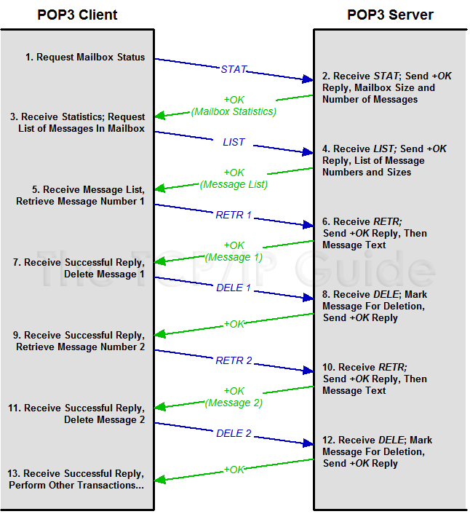

Slide 25
POP3 (more) and IMAP
more about POP3
previous example uses POP3 “download and delete” mode
Bob cannot re-read e-mail if he changes client
POP3 “download-and-keep”: copies of messages on different clients
POP3 is stateless across sessions
IMAP
keeps all messages in one place: at server
allows user to organize messages in folders
keeps user state across sessions:
names of folders and mappings between message IDs and folder name

Slide 26
Questions

